Slide 1
CS3391 Object Oriented Programming
Dr.D.Sivaganesan,
Professor, PSGiTech / CSE
CS3391 Object Oriented Programming Dr.D.Sivaganesan PSGiTech / CSE
1

Slide 2
File is a container of collection related data items.
It is a collection of records, where record is a collections of raw data (or)collection of related fields.
File Operations in Java
Basically, you can perform five operations on a file. They are as follows:
Create a File
Get File Information
Write To a File
Read from a File
Closing the file
CS8392 Object Oriented Programming
Dr.D.Sivaganesan and N.Aravindhraj PSGiTech / CSE
2

Slide 3
File creation File objname=new File(“ path with file name”); Ex: File f = new File(“d:\sample.txt”);
Accessing file methods
fileobj. methodname();
Ex: f.getName();
CS8392 Object Oriented Programming
Dr.D.Sivaganesan and N.Arvaindhraj PSGiTech / CSE
4

Slide 4
Method | Type | Description
canRead() | Boolean | It tests whether the file is readable or not
canWrite() | Boolean | It tests whether the file is writable or not
createNewFile() | Boolean | This method creates an empty file
delete() | Boolean | Deletes a file
exists() | Boolean | It tests whether the file exists
getName() | String | Returns the name of the file
getAbsolutePath() | String | Returns the absolute pathname of the file
length() | Long | Returns the size of the file in bytes
lastModified() | Date | Returns the last modified date with time
CS8392 Object Oriented Programming
Dr.D.Sivaganesan and N.Arvaindhraj PSGiTech / CSE
3

Slide 5
import java.io.*;
import java.util.*;
class exfileop
{
public static void main(String str[])
{
String fname=null; try
{
BufferedReader br= new BufferedReader(new InputStreamReader(System.in)); System.out.println("Enter File Name "); fname=br.readLine();
File f = new File(fname);
if (f.createNewFile())
{ System.out.println("File created: " + f.getName());}
else
{ System.out.println("File already exists.");}
CS8392 Object Oriented Programming Dr.D.Sivaganesan and N.Arvindhraj PSGiTech / CSE
5

Slide 6
System.out.println("Absolute path: " + f.getAbsolutePath());
if(f.exists()) System.out.println("File Exists"); else
System.out.println("File Not Available");
if(f.canWrite())
System.out.println("File has Write Permission"); if(f.canRead())
System.out.println("File has Read Permission"); if(f.canExecute())
System.out.println("File has Execute Permission");
System.out.println("File size is :"+f.length());
System.out.println("Last Modified Date :"+new Date(f.lastModified()));
}
catch(IOException ie)
{System.out.println("IO Error " +ie);}}}
CS8392 Object Oriented Programming
Dr.D.Sivaganesan and N.Arvaindhraj PSGiTech / CSE
6

Slide 7
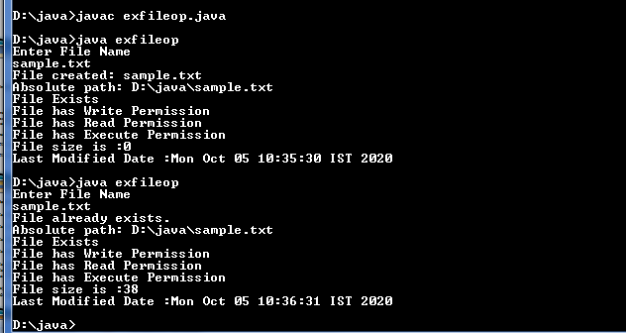
CS8392 Object Oriented Programming
Dr.D.Sivaganesan and N.Aravindhraj PSGiTech / CSE
7

Slide 8
ByteStream
This is used to process data byte by byte (8 bits).
FileInputStream and the FileOutputStream are the most popular ones.
The FileInputStream is used to read from the source and
FileOutputStream is used to write to the destination.
STREAM CLASS | DESCRIPTION
BufferedInputStream | It is used for Buffered Input Stream.
DataInputStream | It contains method for reading java standard datatypes.
FileInputStream | This is used to reads from a file
InputStream | This is an abstract class that describes stream input.
PrintStream | This contains the most used print() and println() method
BufferedOutputStream | This is used for Buffered Output Stream.
DataOutputStream | This contains method for writing java standard data types.
FileOutputStream | This is used to write to a file.
OutputStream | This is an abstract class that describe stream output.
CS8392 Object Oriented Programming
Dr.D.Sivaganesan and N.Aravindhraj PSGiTech / CSE
9

Slide 9
CharacterStream:
Character streams are used to perform input and output for 16-bit unicode.
Character stream automatically allows us to read/write data character by character.
FileReader and the FileWriter are the most popular ones.
FileReader and FileWriter are character streams used to read from the source and write to the destination respectively.
STREAM CLASS | DESCRIPTION
BufferedReader | It is used to handle buffered input stream.
FileReader | This is an input stream that reads from file.
InputStreamReader | This input stream is used to translate byte to character.
OutputStreamReader | This output stream is used to translate character to byte.
Reader | This is an abstract class that define character stream input.
PrintWriter | This contains the most used print() and println() method
Writer | This is an abstract class that define character stream output.
BufferedWriter | This is used to handle buffered output stream.
FileWriter | This is used to output stream that writes to file.
CS8392 Object Oriented Programming
Dr.D.Sivaganesan and N.Aravindhraj PSGiTech / CSE
10

Slide 10
Byte Stream Classes
Writing a file
FileOutputStream objname=new FileOutputStream(“file name”);
Ex: FileOutputStream f=new FileOutputStream(“sample.txt”);
Reading a file
FileInputStream objname=new FileInputStream(“file name”);
Ex: FileInputStream f=new FileInputStream(“sample.txt”);
Character Stream Classes
Writing a file
FileWriter objname=new FileWriter (“file name”);
Ex: FileWriter f=new FileWriter(“sample.txt”);
Reading a file
FileReader objname=new FileReader (“file name”);
Ex: FileReader f=new FileReader (“sample.txt”);
CS8392 Object Oriented Programming
Dr.D.Sivaganesan and N.Arvaindhraj PSGiTech / CSE
8

Slide 11
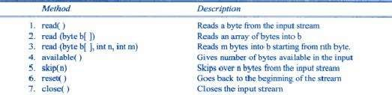

InputStream reading
OutputStream Writing
CS8392 Object Oriented Programming
Dr.D.Sivaganesan and N.Aravindhraj PSGiTech / CSE
9

Slide 12
import java.io.*;
import java.util.Scanner;
public class exfilebs{
public static void main(String[] args) throws IOException
{ String name; String d; String rollno;
System.out.println(" Enter name, dept,roll no");
try{
Scanner s = new Scanner(System.in);
rollno = s.nextLine(); name=s.nextLine();
d=s.nextLine();
FileWriter outf = new FileWriter("D:siva1.txt"); outf.write(rollno);outf.write("\n"); outf.write(name);outf.write("\n"); outf.write(d);outf.write("\n");
outf.close();
}catch(IOException e1)
{System.out.println(e1);}
CS8392 Object Oriented Programming
Dr.D.Sivaganesan and N.Aravindhraj PSGiTech / CSE
10

Slide 13
try{
FileInputStream inf = new FileInputStream("D:siva1.txt"); Scanner sc=new Scanner(inf);
System.out.println(" name dept roll no");
while (sc.hasNextLine())
{
System.out.print(sc.nextLine());
}
inf.close();
}
catch(IOException e)
{
System.out.println(e);
}}}
CS8392 Object Oriented Programming
Dr.D.Sivaganesan and N.Araindhraj PSGiTech / CSE
11

Slide 14
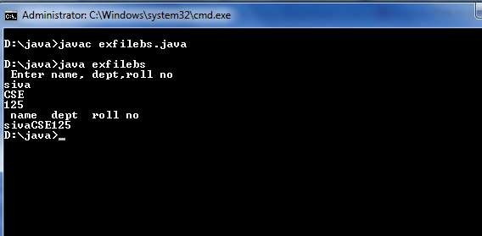
CS8392 Object Oriented Programming
Dr.D.Sivaganesan and N.Aravindhraj PSGiTech / CSE
12

Slide 15
FileReader
import java.io.*;
public class exfr
{public static void main(String[] args) throws IOException
{FileReader source = null;
try
{source = new FileReader("d://WriteInt.txt");
// Reading sourcefile and writing content to target file character by character.
int temp;
while((temp = source.read()) != -1) System.out.print((char)temp);
}finally
{// Closing stream as no longer in use
if(source != null)
source.close(); }}}
CS8392 Object Oriented Programming
Dr.D.Sivaganesan and N.Aravindhraj PSGiTech / CSE
13

Slide 16
File Input and Output Streams
import java.io.*;
class exfs
{
public static void main(String args[]) throws Exception
{
FileInputStream fin=new FileInputStream("deep.java"); FileOutputStream fout=new FileOutputStream("new.java"); int i=0;
while((i=fin.read())!=-1)
{ fout.write((byte)i);
}
fin.close();
}
}
CS8392 Object Oriented Programming
Dr.D.Sivaganesan and N.Aravindhraj PSGiTech / CSE
14

Slide 17
class exprintf
{ public static void main(String args[])
{ int x = 502;
System.out.printf("Printing simple integer: x = %5d\n", x); float y=12.146f;
// this will print it upto 2 decimal places System.out.printf("Formatted with precison: y = %.2f\n", y);
float n = 5.2f;
// automatically appends zero to the rightmost part of decimal System.out.printf("Formatted to specific width: n = %.4f\n", n); n = 123467.3f;
// here number is formatted from right margin and occupies a
// width of 10 characters
System.out.printf("Formatted to right margin: n = %10.4f\n", n);
String str="sivaganesan";
System.out.printf("Formatted to string s = %14s\n", str); } }
CS8392 Object Oriented Programming
Dr.D.Sivaganesan and N.Aravindhraj PSGiTech / CSE
15

Slide 18
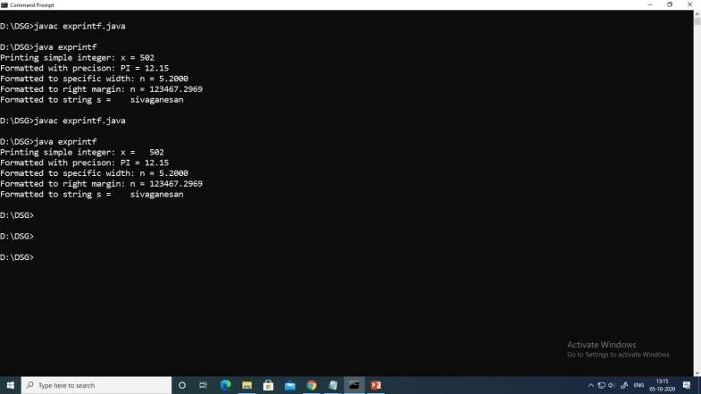
CS8392 Object Oriented Programming Dr.D.Sivaganesan and N.Arvindhraj PSGiTech / CSE
16

Slide 19

CS8392 Object Oriented Programming
Dr.D.Sivaganesan and N.Arvindhraj PSGiTech / CSE
17

